Slide 1

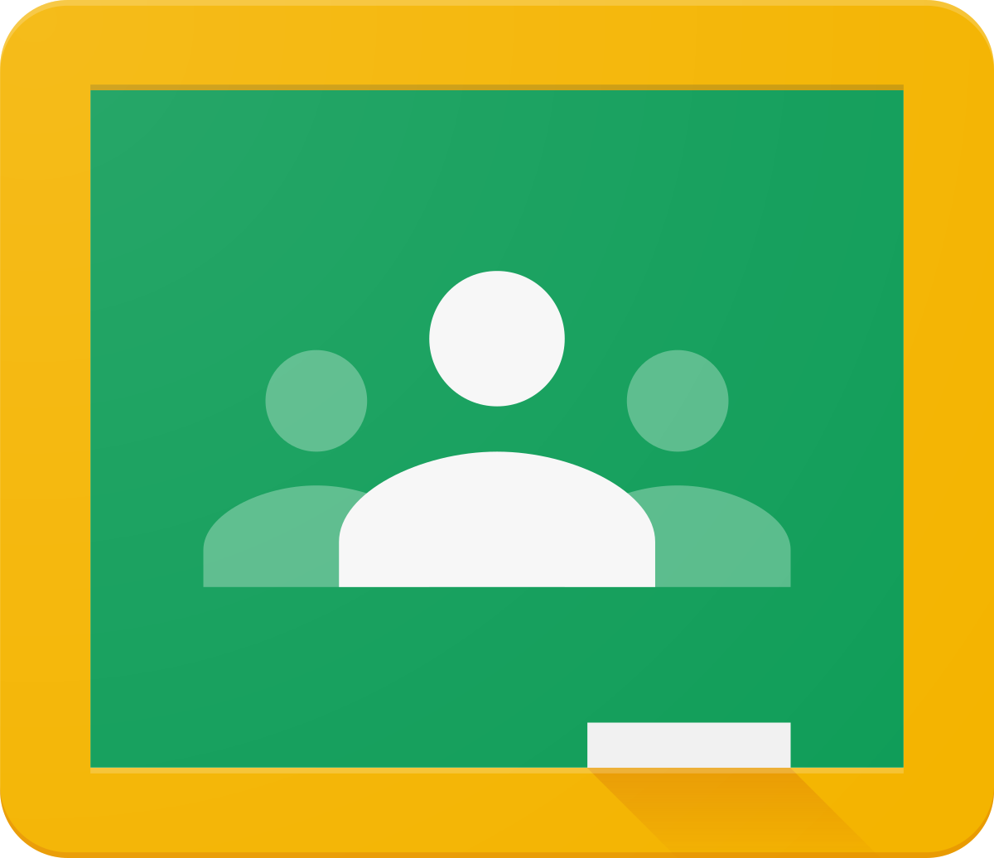
Holtspur school
Accessing Work on Google Classroom

Slide 2
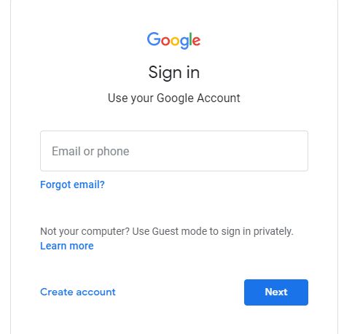
Step One
Login to Google Classroom using the following website and the login details sent to you.
classroom.google.com

Slide 3
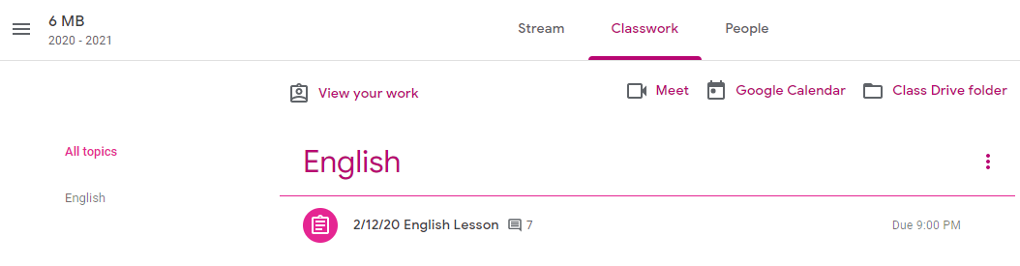
Step Two
Click on the Classwork tab at the top of the screen.

Slide 4
Step Three
Click on the side tabs to take you to a specific subject. You will then see the lessons come up on the page. Click on the lesson you would like to complete.

Slide 5
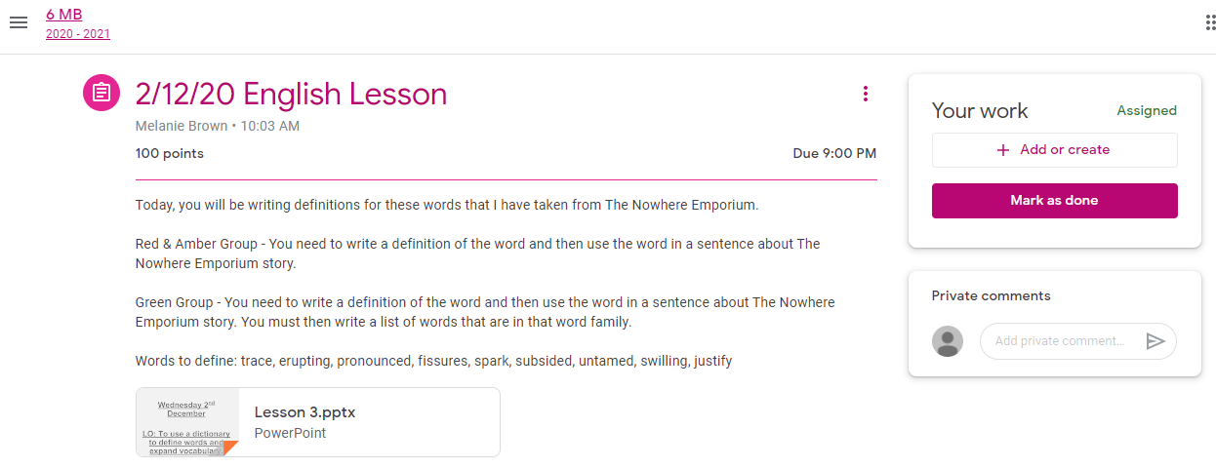
This is where the instructions from the teacher will be.
Click ‘Add or Create’ to either upload a file of your work OR create a new document for your work.
This will tell you when your work is due!
Type here to send a private comment to your teacher.

Slide 6
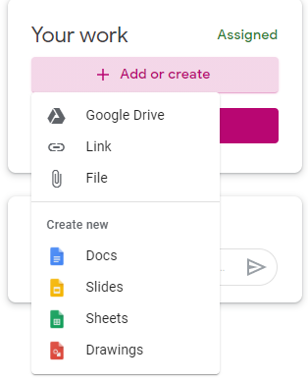
When you clock ‘Add or Create’, you will be given these options..
Use one of these options to upload something from your computer/ laptop/device.
Use one of these options to create a new document.

Slide 7
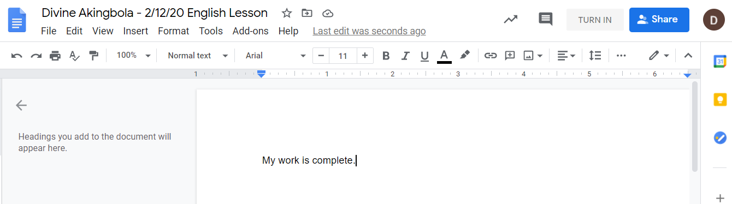
Once your work is complete, click here to send it in to your teacher.

Slide 8
For more support, this YouTube video is very helpful on how to view and submit work ☺
https://www.youtube.com/watch?v=o4JeCTfhvnI
You can also contact your class teacher for further support.

